Slide 1
MULESOFT
SAI KIRAN YALAKALA

Slide 2

Index
Introduction about Mulesoft , API & Postman
API-LED Connectivity
Anypoint Platform (Design Center, Exchange, Runtime manager & API Manager)
Mule4 Structure (Set Payload, Attributes & Set Variable )
Anypoint Studio (Package Explorer, Canvas, Palette & Console)
Flows (Flow, Subflow & Private Flow)
Flow reference
Connectors (FTP, SFTP, MySQL, Salesforce & AWS)
Automated & Manual Project
Transform Message
Configuration properties
DataWeave ()
Choice Reutter
Scatter Gather
Error Handling (On-error Continue, On Error Propagation & Raise Error)

Slide 3
What is Mulesoft
Drag and Drop tool
Integration platform
Business data connector (Communicates between 2 or more systems)
Acquired by Salesfore on May’2018
Founded in 2006 by Ross Mason
Mule = Donkey + Horse
Competitors : DELL BOOMI, TIBCO etc…
EAI Product

Slide 4
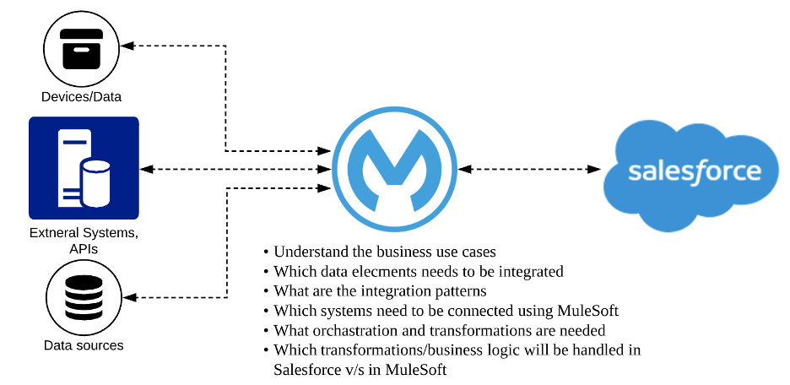
What is Integration
Integration is the act of bringing together smaller components into a single system that functions as one
Integration is the process of connecting multiple enterprise systems, devices, or applications to work as a whole
Milk + Water + Sugar+Tea powder = Tea

Slide 5
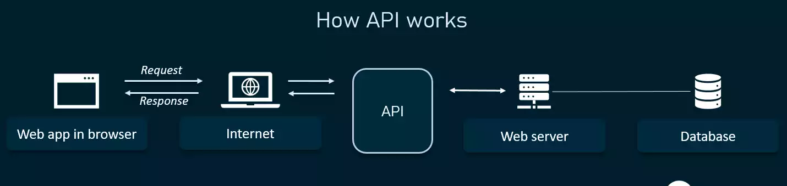
What is an API
An API is a set of programming code that enables data transmission between one software product and another. It also contains the terms of this data exchange.
Reusable piece of code
Divided into 3 Layers
System API
Process API
Experience API

Slide 6
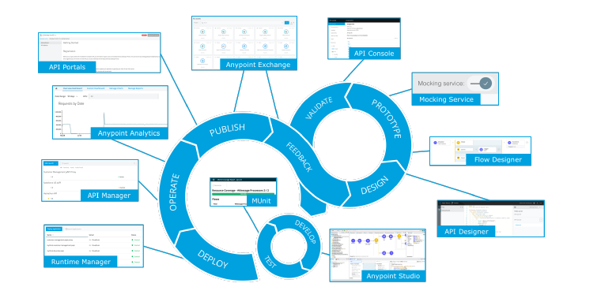
What is an API specification
API Specification is nothing but how an API works
What kind of request is accepts
What kind of Response it returns
Mandatory fields
Schema validation (Datatypes)
Reliability pattern
API Life Cycle

Slide 7
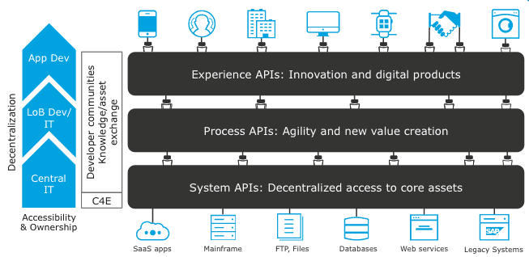
API LED Connectivity

Slide 8
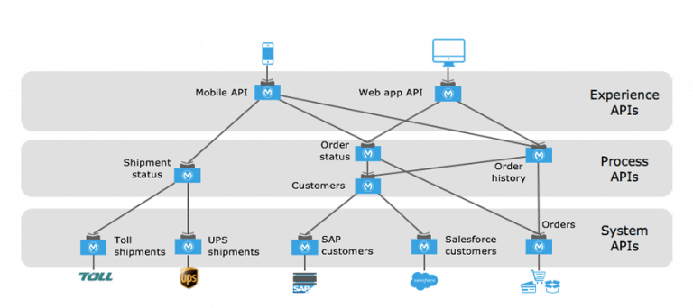
Architecture

Slide 9
API LED Connectivity – Real Time
Manager need an employee details where employee id is 888777
Logic: Browser->EmployeeID :888777-> Should be 6 digits ->DB
Response: {
“name”: “Saikiran”,
“Skill”: “MuleSoft”
“Lcation”: Hyderabad
}
Manager SAPI: Database logic (Select * from employees where employeeId=attributes.queryparams.id)
Manager PAPI : Business logic (Should be 6 digits/Should not be empty/Only Numbers)
Manager EAPI/XAPI: URL expose

Slide 10
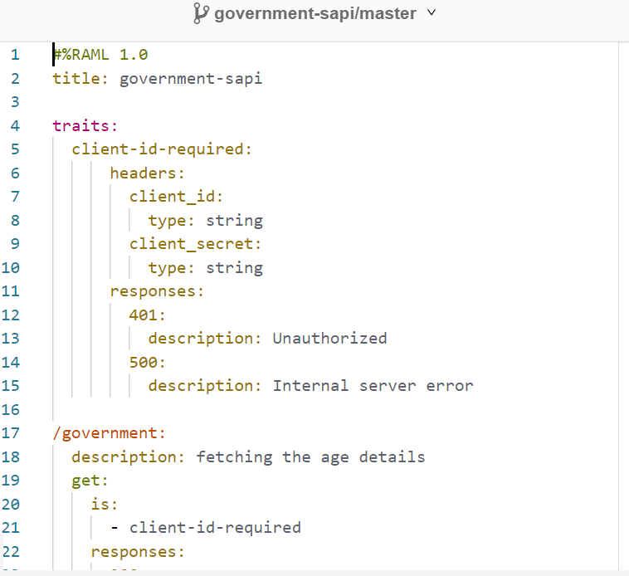
Government SAPI : Used to fetch raw details from end system

Slide 11
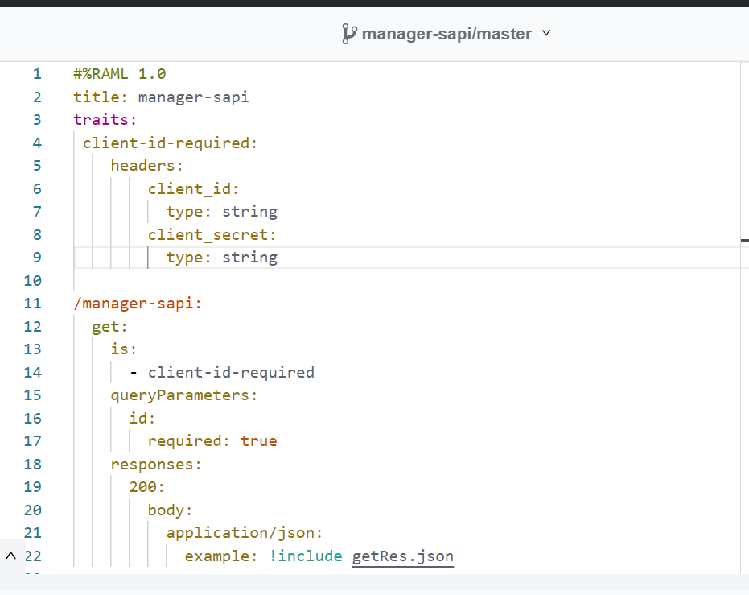
ClientID & ClientSecret Enforcement
Traits: To enforce the policies
Defining Traits: Go to API manager -> Policies -> Get ClientID & ClientSecret Policies
https://docs.mulesoft.com/api-manager/2.x/prepare-raml-task

Slide 12
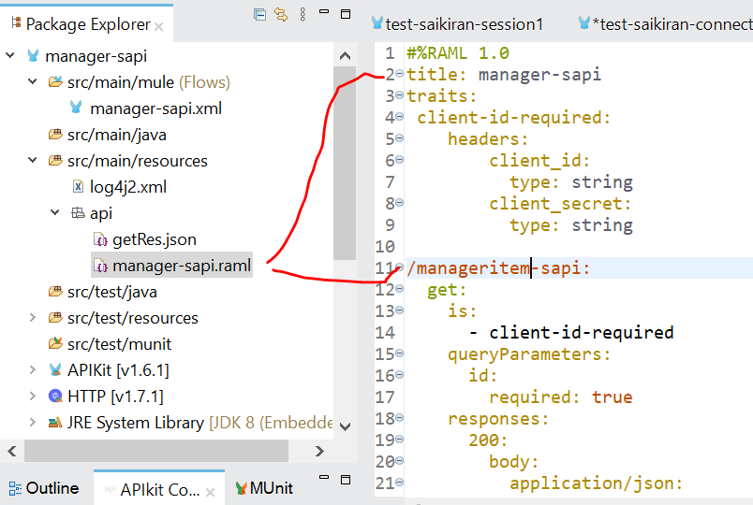
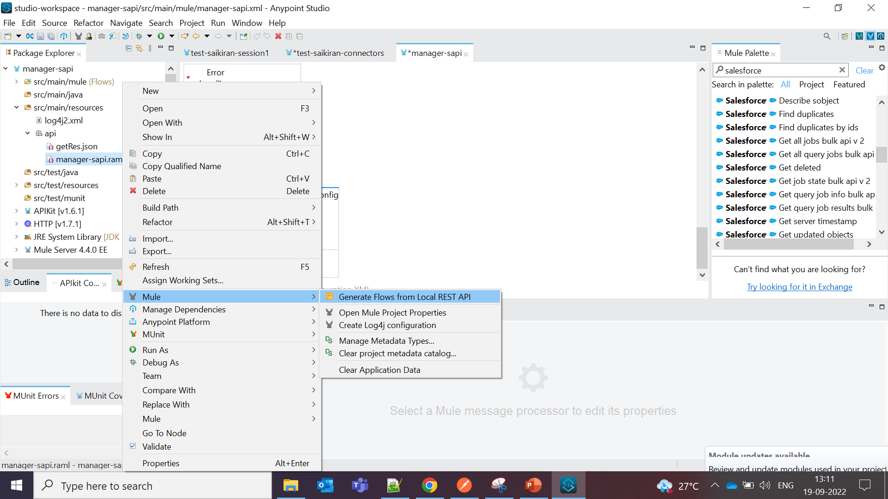
Publish to Exchange & Import to Studio, Changing Resource name
Create a new project & Import the RAML zip file
If Manager-sapi api name is changed to manageritem-sapi in RAML
Goto: src/main/resources -> api ->sapi.raml > generate flow from local rest api
Change will be deployed – Check once

Slide 13
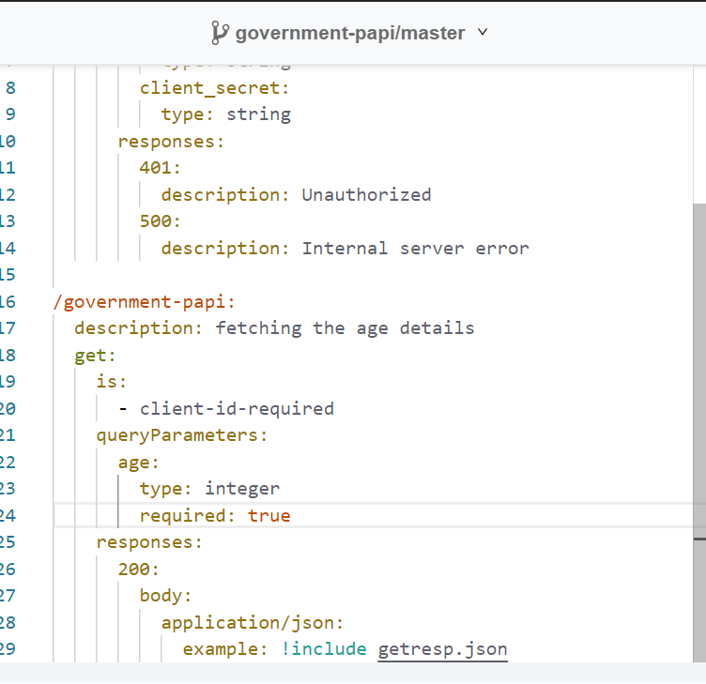
Government-PAPI (RAML)
Business logic is required in PAPI
The Business logic here is (if Age > 60, “Eligible for pension” else, “NOT”

Slide 14
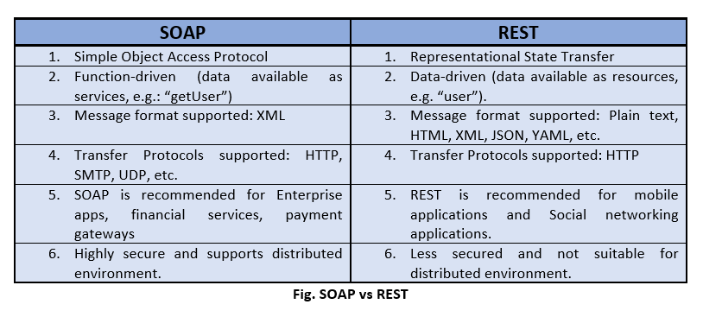
Rest and SOAP web services

Slide 15
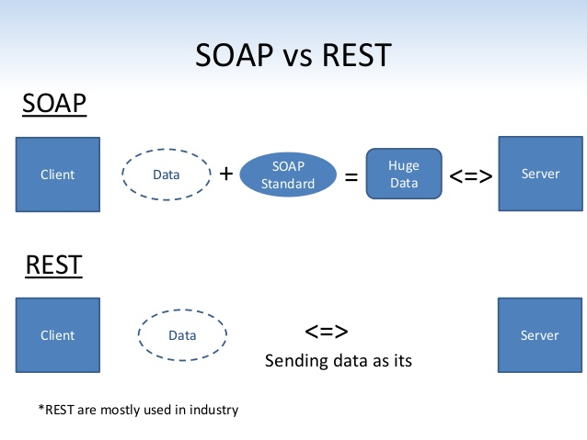

Slide 16
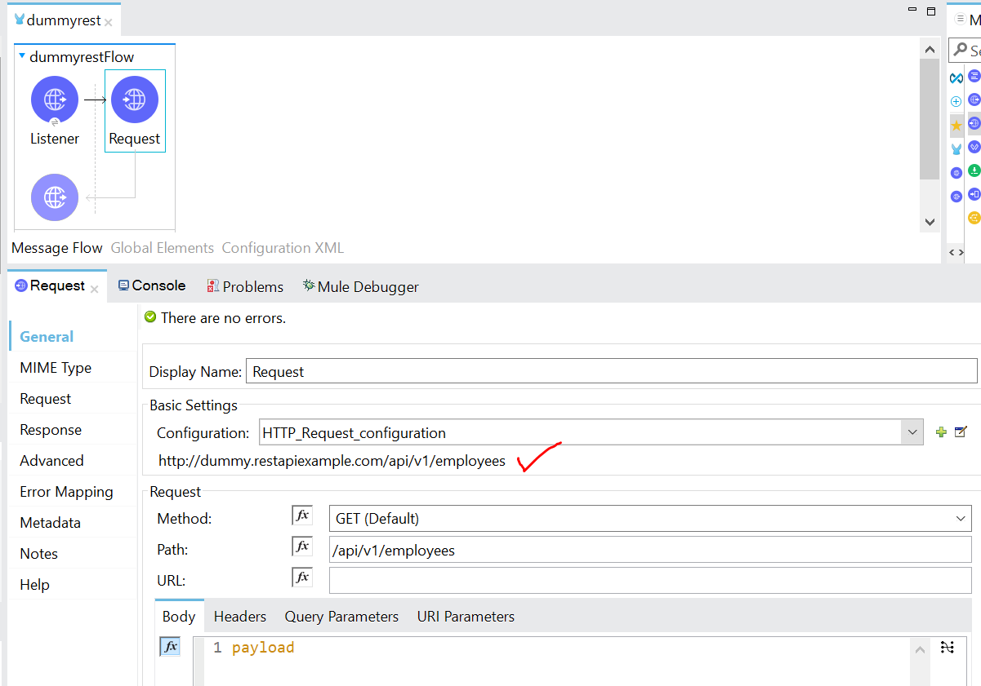
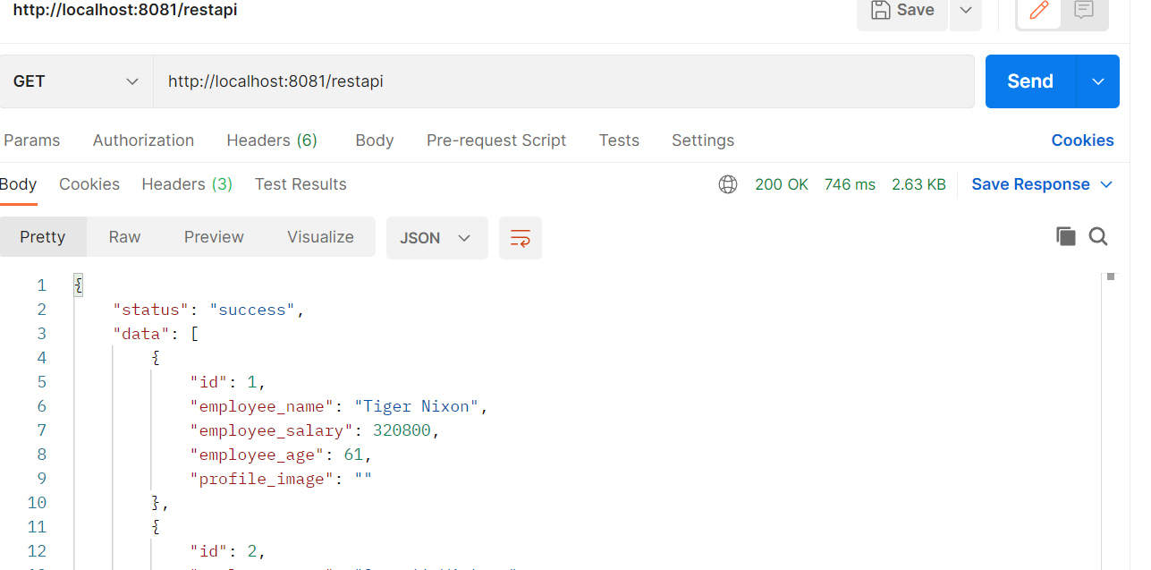
Invoking Rest API
External Rest API : https://dummy.restapiexample.com/api/v1/employees

Slide 17
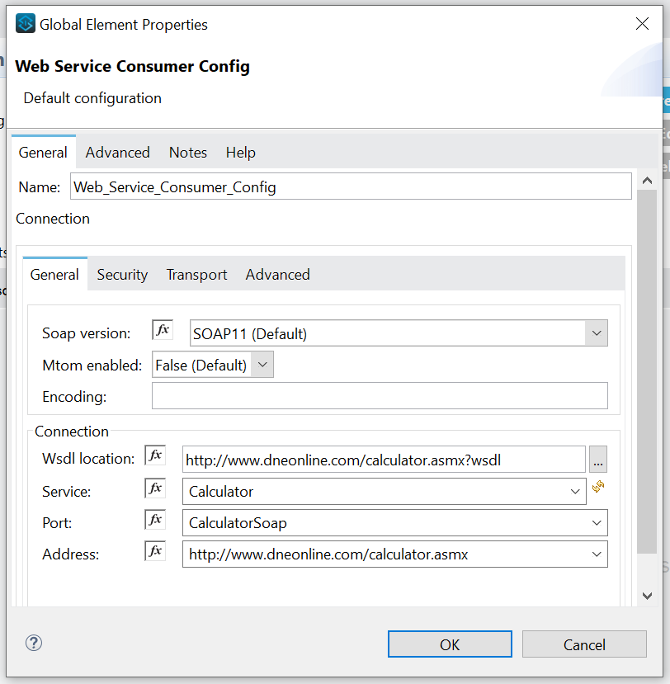
Invoking SOAP API
SOAP UI website: https://www.soapui.org/docs/soap-and-wsdl/working-with-wsdls/
SOAP WSDL Example: http://www.dneonline.com/calculator.asmx?wsdl
Setup
Connector: Web Service consume
Configure with the URL example
Service, Port and Address will come by default
Use (Add, Multiply, Divide) operator as of requirement

Slide 18
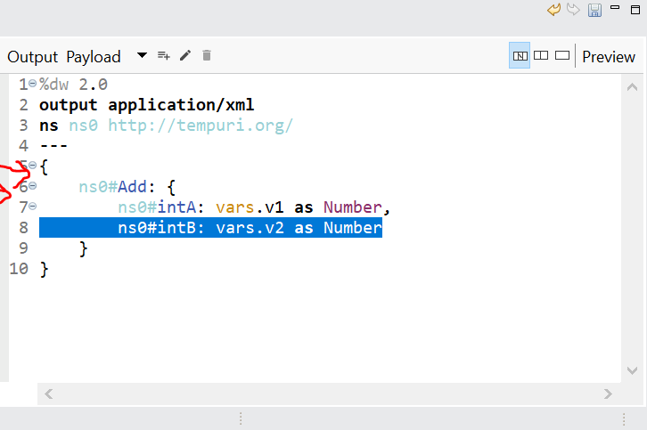
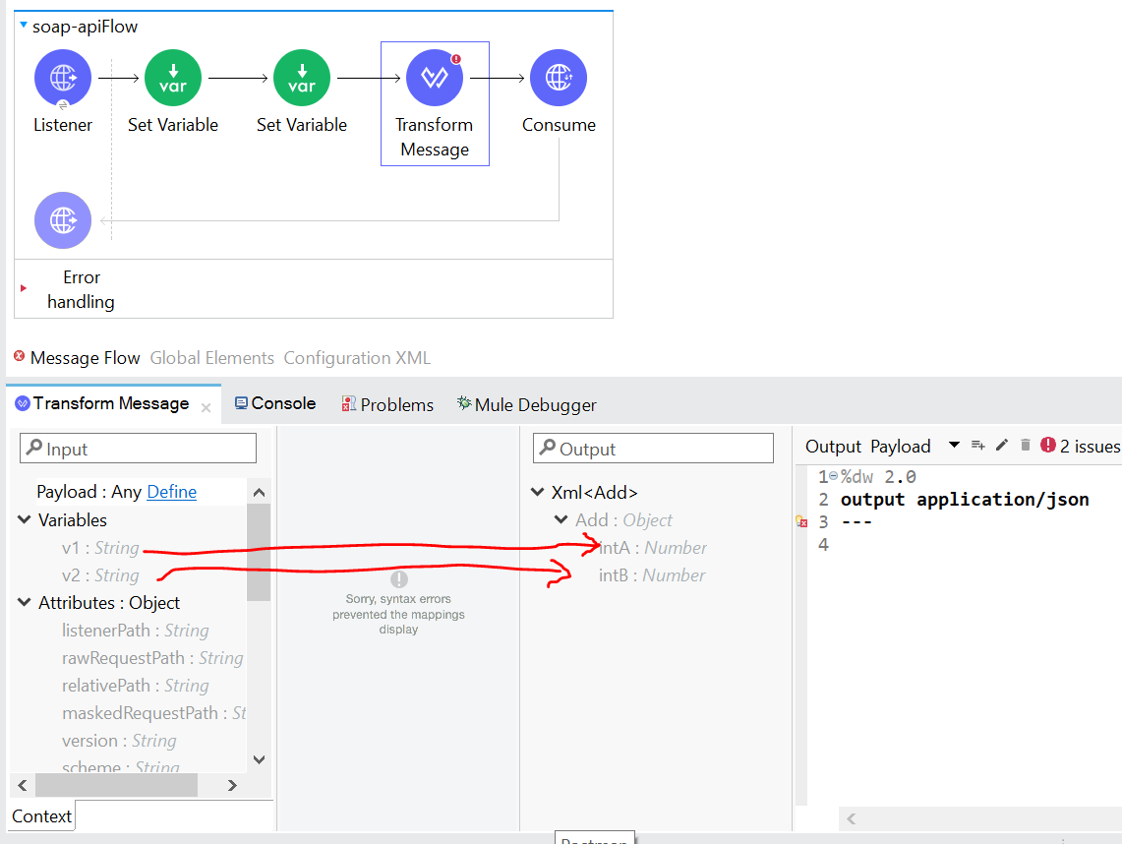
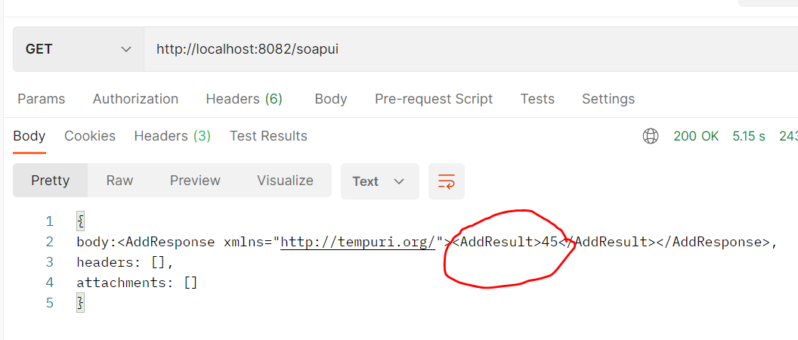
Soap API : Mapping & Response

Slide 19
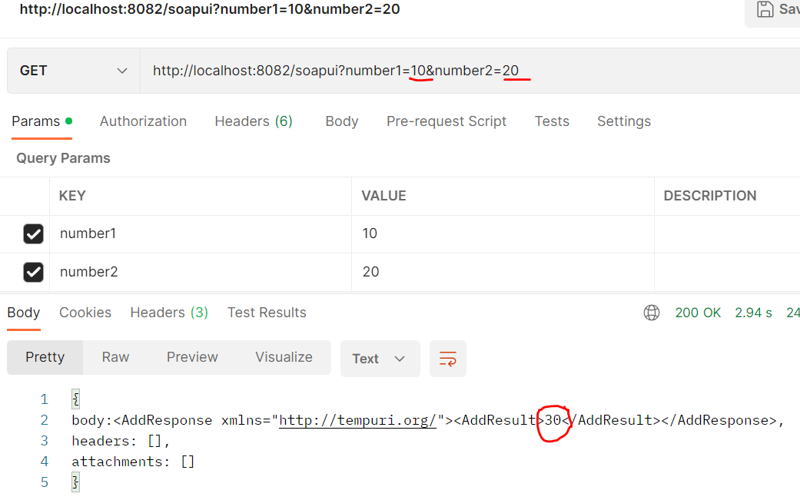
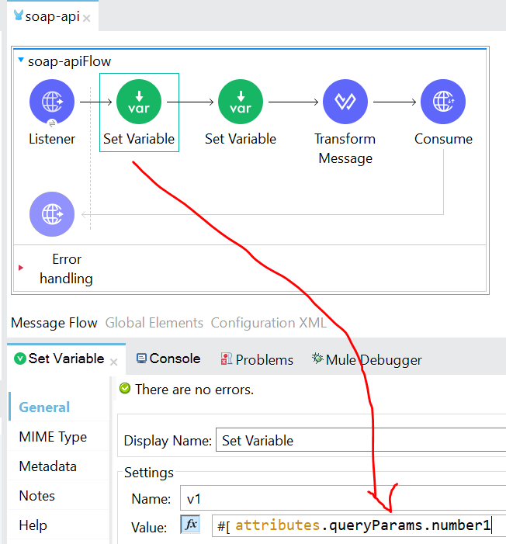
Passing variables in Postman via queryParams but not in value

Slide 20
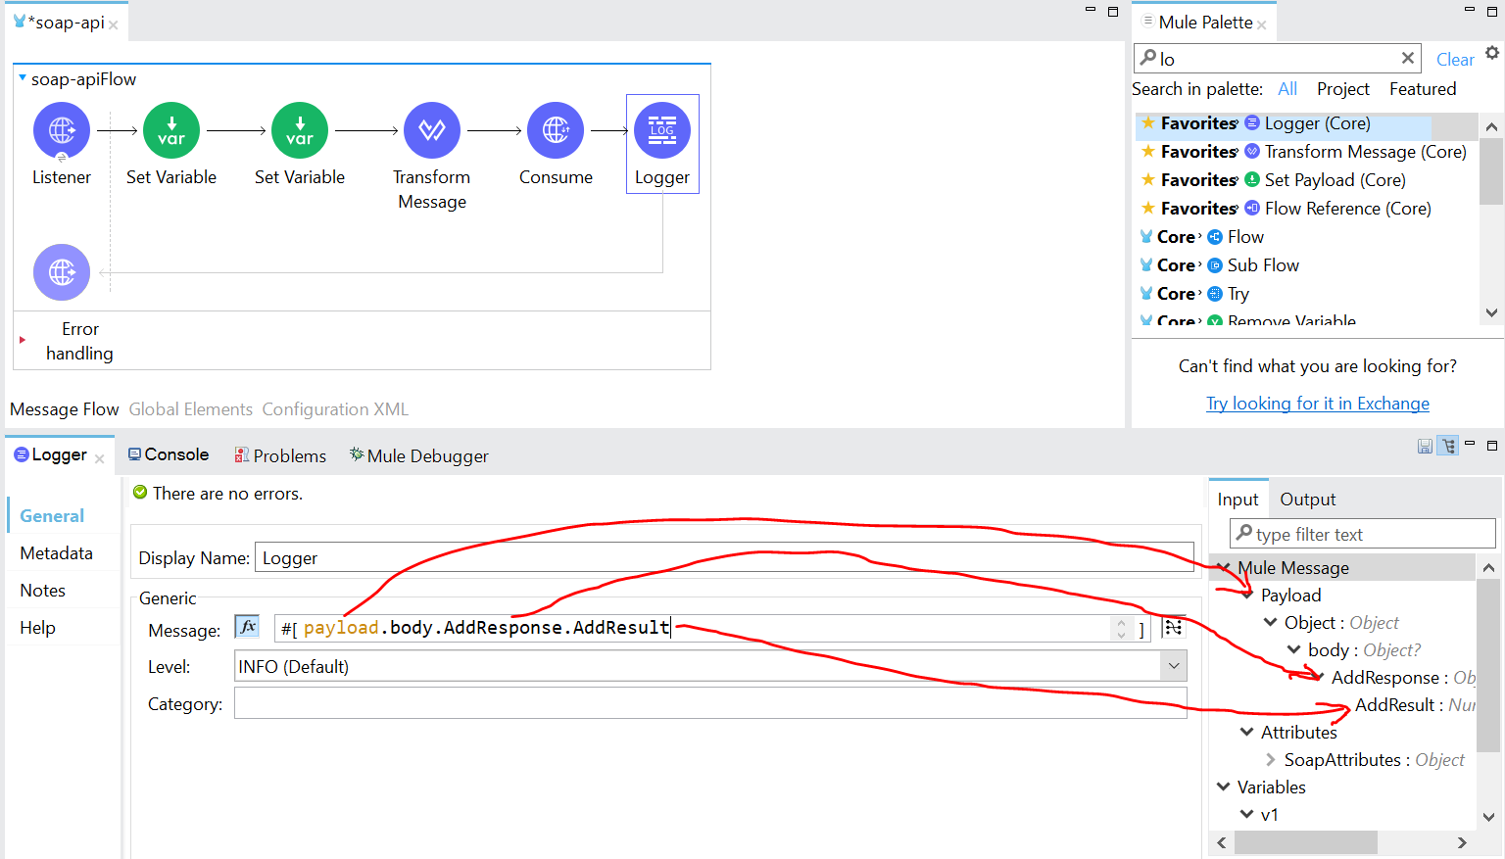
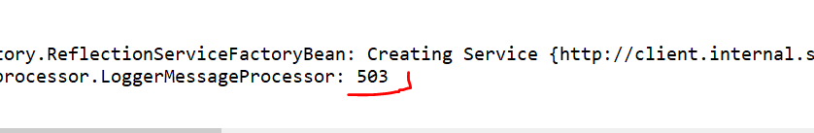
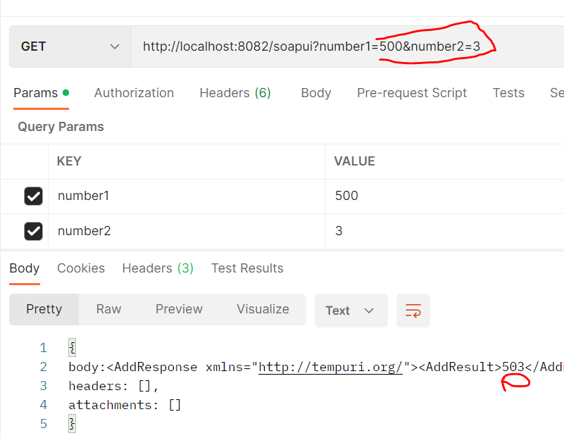
How to Print the result in Logger

Slide 21
Anypoint Platform
Design Center - Design and develop API's
Anypoint Exchange - Place where we will be able to share, discover api's and reusable assets
API Manager - Helps in Managing API's by invoking policies
Runtime Manager - Where applications are deployed
Access management -Configure access and permissions within organization
Anypoint Monitoring/Visualizer-Provides monitoring and real-time graphical representation of API's
Secret Manager - Place to store and control access to private keys, passwords, cerificates

Slide 22
Design Center: (Designing RAML)
Resource Name : Should be unique
Method : Get, Post, Put, Delete, Fetch
Request : Contains Body, Resource path, Uri path, Query param
Response
Http status: 200, 201, 202, 400, 401, 404, 500...
Design center to Exchange
Postman Testing
Resource path, Query & Uri param

Slide 23
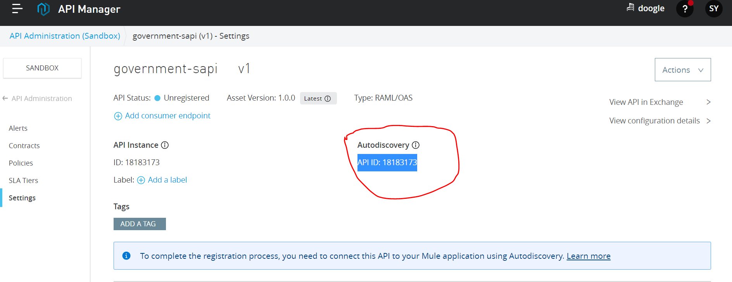
API Manager
Used to apply policies
With Autodiscovery we cannot test the application with dummy ClientID & clientSecret
What is Autodiscovery
API Auto Discovery is used to connect Runtime manager deployed applications with API created on the platform

Slide 24
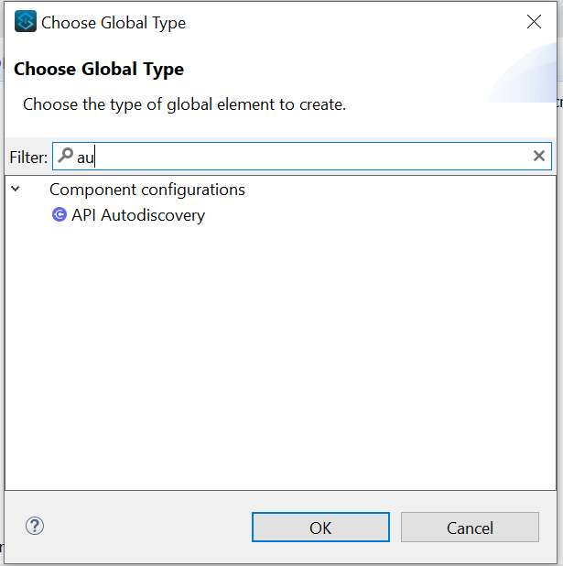
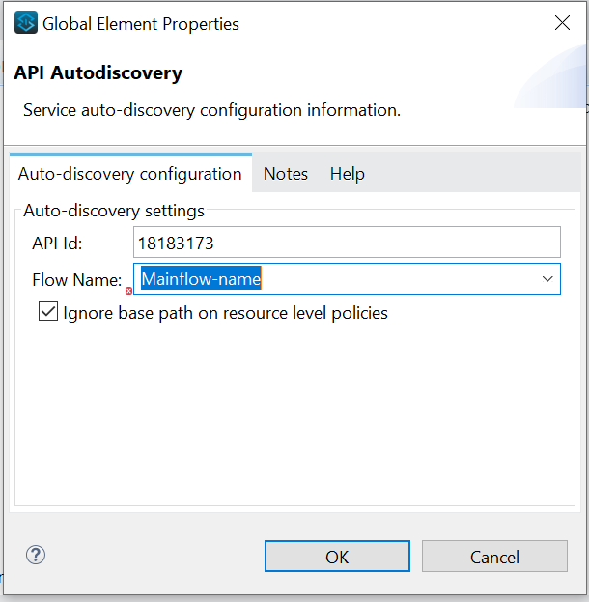
Adding AutoDiscoveryID in Studio
AutodiscoveryID is used to interact between Runtime manager and API manager
Copy AutodiscoveryID (Eg: 18183173)
Apply AutodiscoveryID in Studio inside Global elements -> Create -> Search -> API Discovery -> API ID, FlowName (Always main flow)

Slide 25
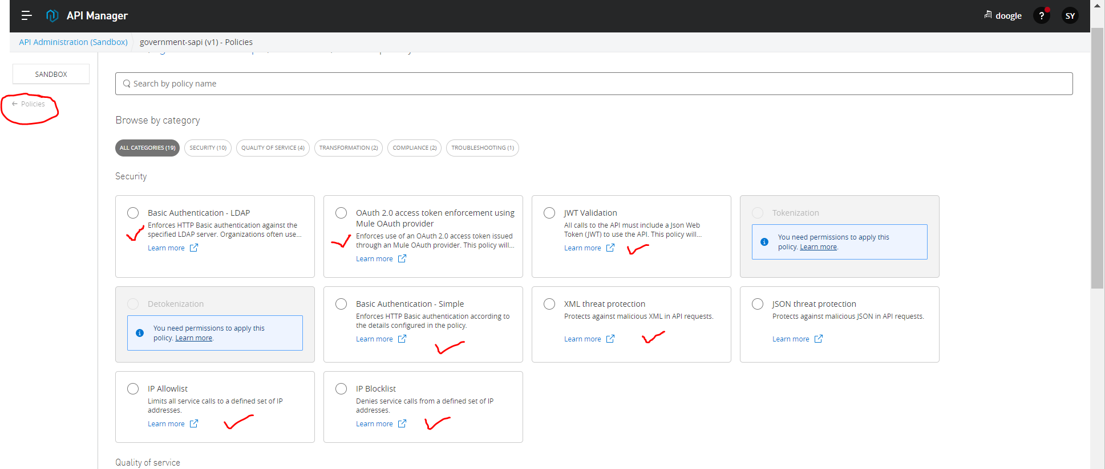
Policies
Client_id enforcement
Rate limiting
IP blocklist
IP whitelist
Jwt validation
Basic Auth

Slide 26
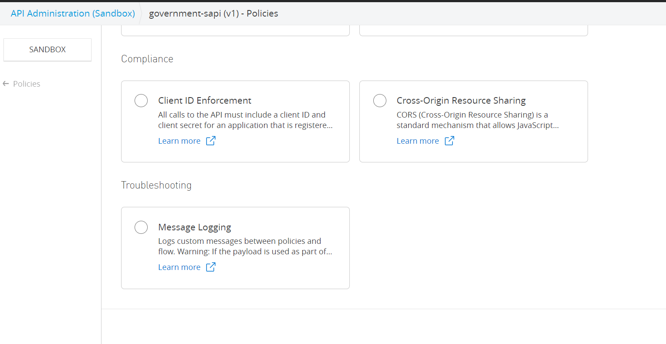
Most Used Policy : Cliend ID Enforcement

Slide 27
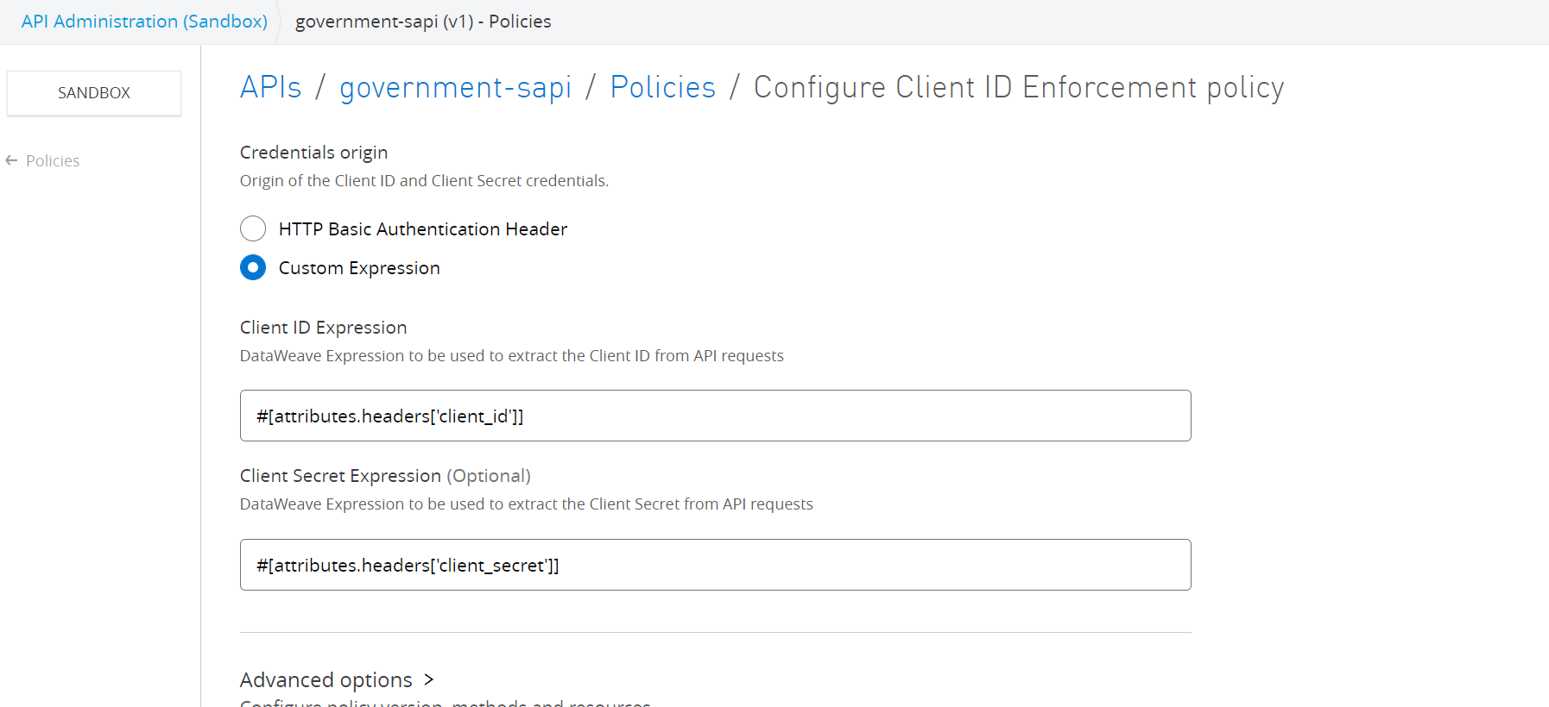
Applying client enforcement policy

Slide 28
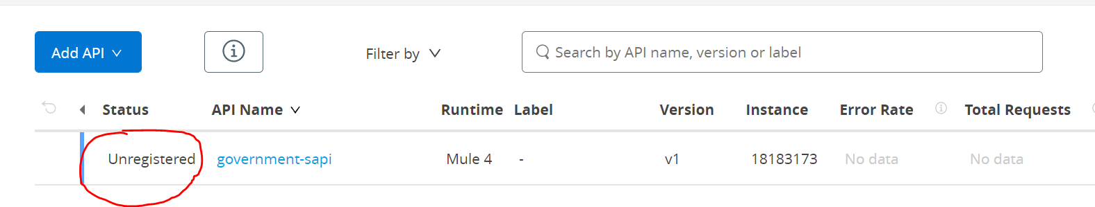
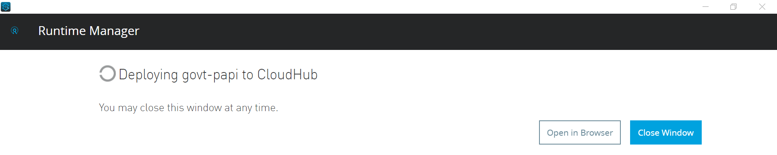
Unregistered to Registered status via cloudhub deployment

Slide 29
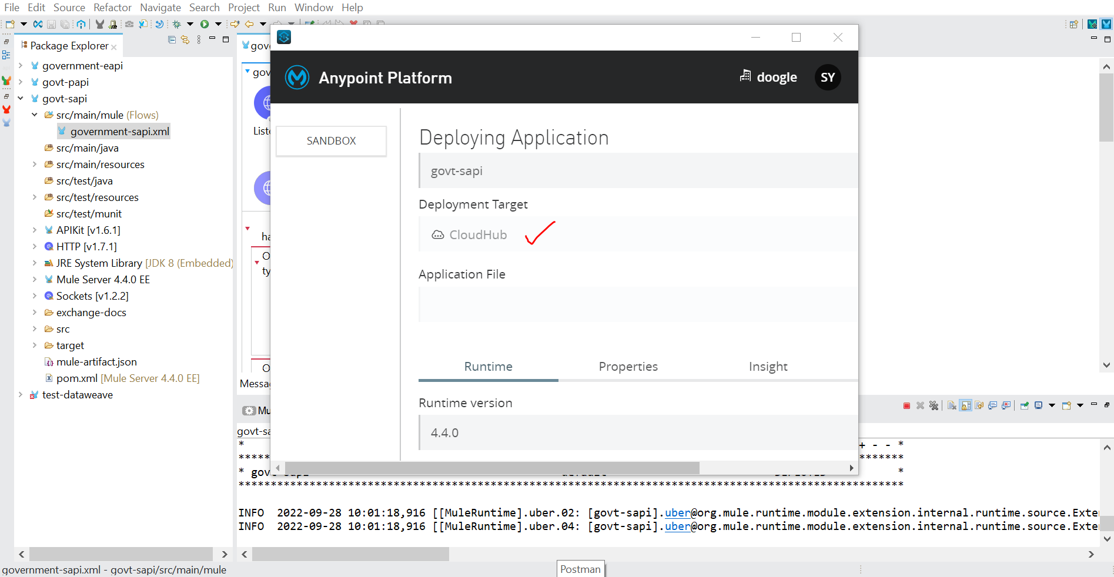
Runtime Manager: Deploy to cloudhub via Studio

Slide 30
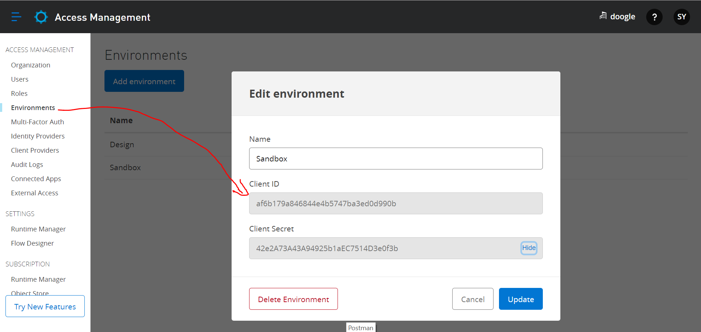
AccessManagent: Get ClientID & ClientSecret

Slide 31
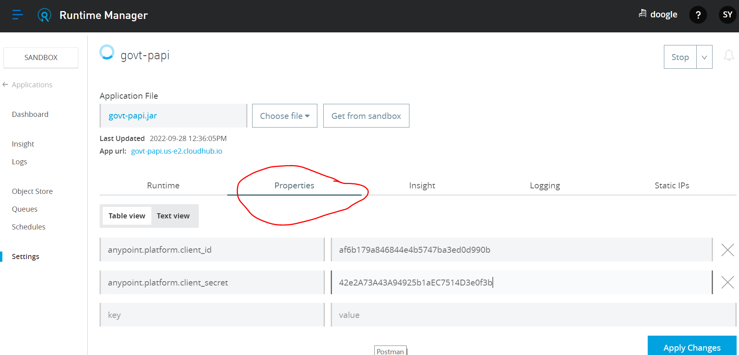
Pasting ClientID & ClientSecret in Runtime Properties

Slide 32
Policies &Uses
Basic Auth -> Asks Username & Password
ClientID Enforcement -> Requires client_id & client_secret
Rate Limiting -> Send the set amount of request for particular time period
IP Whitelist : Having Access to the Ip’s which are in the list
IP Blacklist: Does not have access to the IP’s mentions in the list

Slide 33
Additional about RAML & Status codes:
Creating folder for code simplicity (! include FILENAME in Type -- application/json)
https://http.cat/
( Example status codes)
https://github.com/raml-org/raml-spec/blob/master/versions/raml-10/raml-10.md/
(More about RAML)

Slide 34
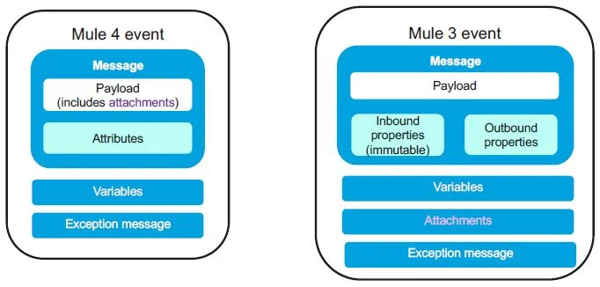
Mule3 vs Mule4 Structure

Slide 35
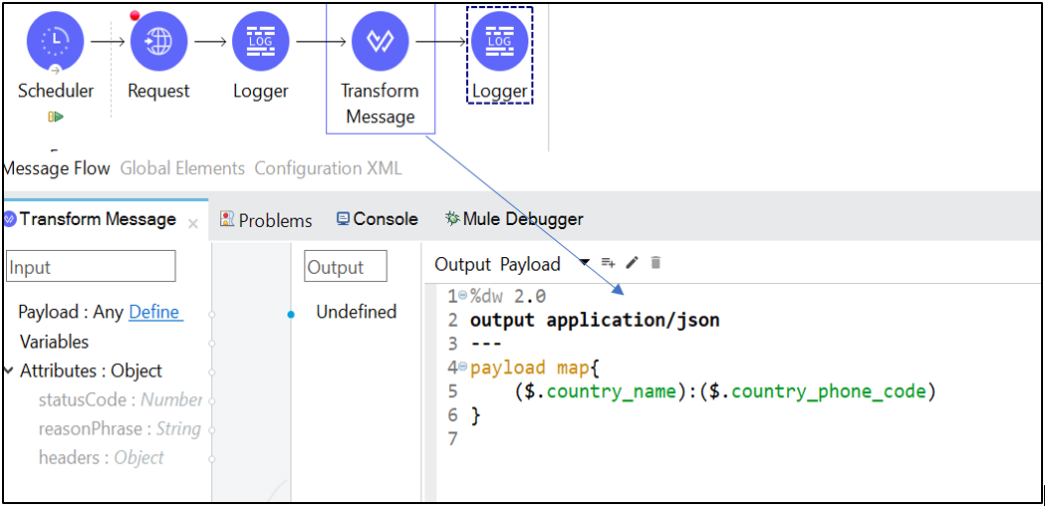
What is Payload? (Part of Mule Message)
Payload is an actual message content. Payload can be overridden

Slide 36
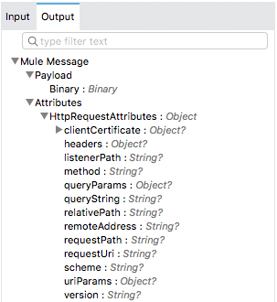
What is Attribute? (Part of Mule Message)
This provides Metadata such as queryparams, File size etc. These are immutable(Cannot be changed)

Slide 37
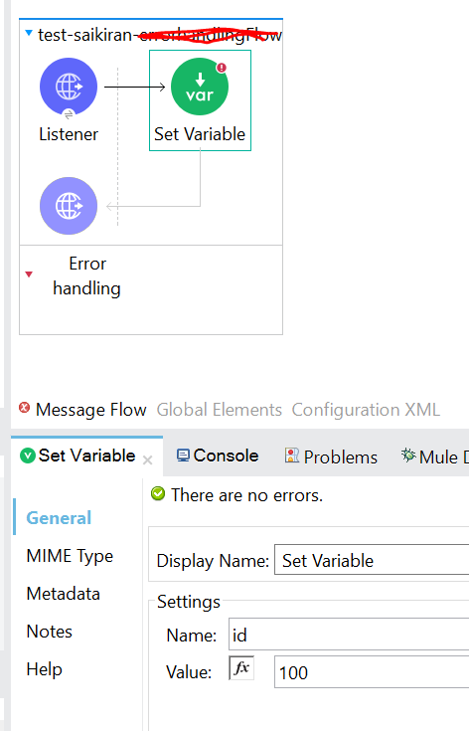
What are Variables? (Part of Mule event)
These are which you can store some kind of data or information and can be used accross the application as long as you connect the flow with flow-ref
Set Payload:
Used to Set the variable
Set variable can be called in Payload
Example: “My Name is ” ++ vars.name ++ “My id is ” ++vars.id

Slide 38
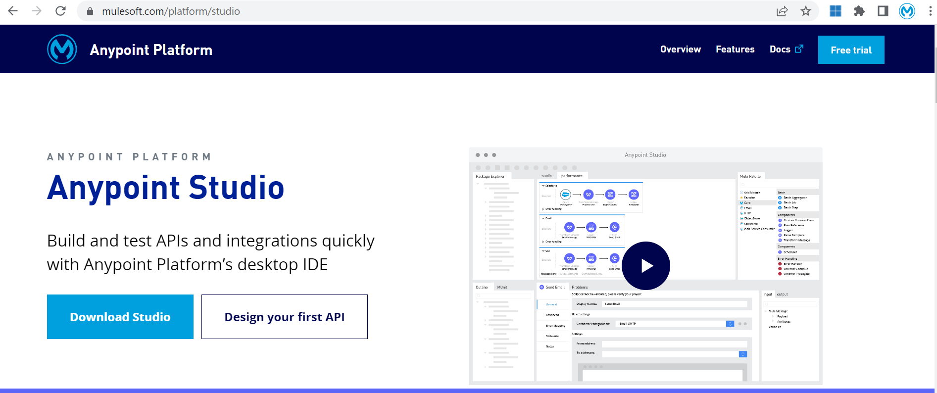
Anypoint Studio
Link to Install: https://www.mulesoft.com/platform/studio

Slide 39
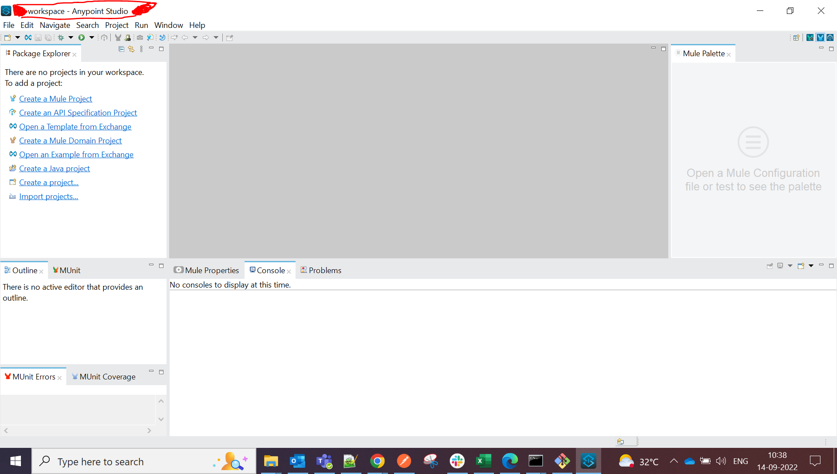
Anypoint Studio Explanation
Package explorer
Palette
Canvas
Console

Slide 40
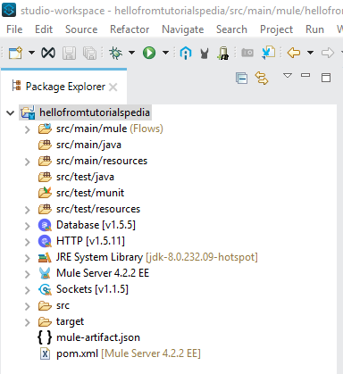
Important points about Mule
Mulesoft is a Mavenized project
All Mule xml’s are placed under src/main/mule
Other files can be placed under: src/main/resources or src/test/resources
Mule-artifact.json
Each mule app xml has – Message flow(graphical view), Global elements(all config details), Configuration xml (xml version or graphical view)

Slide 41
Flow, Sub-flow & Private flow
Flow is a message processing block that has its own processing strategy and exception handling strategy. Used in integration tasks, data processing, connecting applications, event processing, etc.
Subflow always processes messages synchronously but inherits processing strategy and exception handling strategy from the calling flow. It can be used to split common logic and be reused by other flows.
Private flow does not have source define. It can be synchronous or asynchronous based on the processing strategy selected. Also they have their own exception handling strategy. Allows you to define different threading profile.

Slide 42
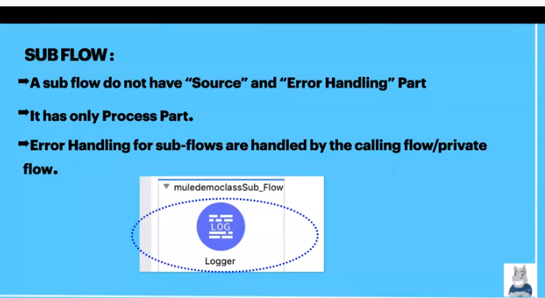
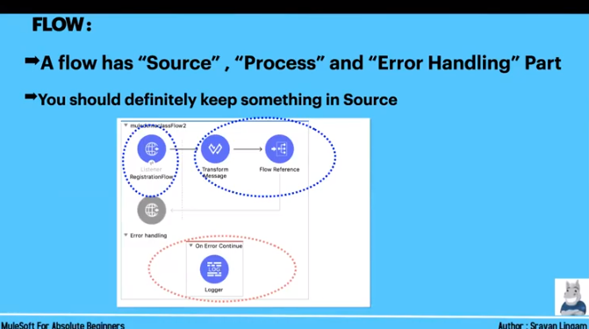
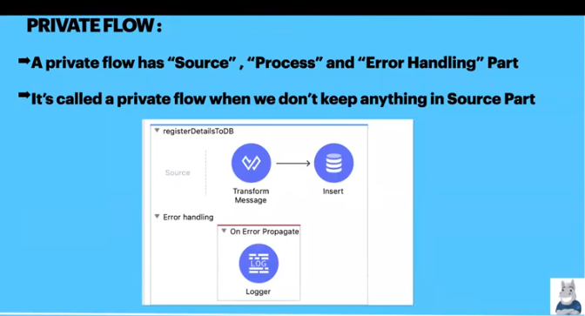
Flow | Sub Flow | Private Flow
Flow have Source, Process and Error handling part | A flow that do not have Source and Error handling | A flow that have Source, Process & Error handling
We will give reference to other flows based on requirement | Having only Process part | We will call it as private flow when source part is empty
Private-Flow
Sub-Flow
Flow

Slide 43
Automated vs Manual Project
Automated : Scheduler + Logger
Manual: Listener+logger

Slide 44
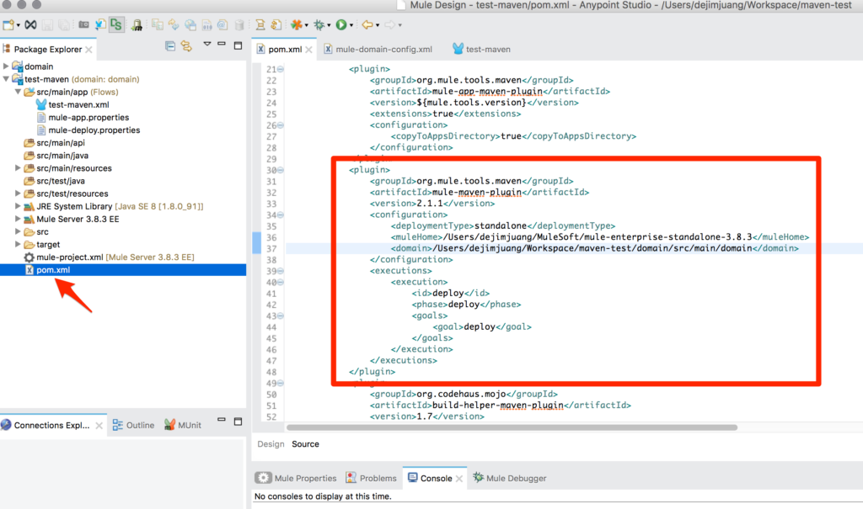
Pom.xml
The pom. xml file contains the core information about a project and its configuration details including its dependencies, build directory, source directory, test source directory, plugin, goals etc. Maven reads the pom. xml file, then executes the goal.

Slide 45
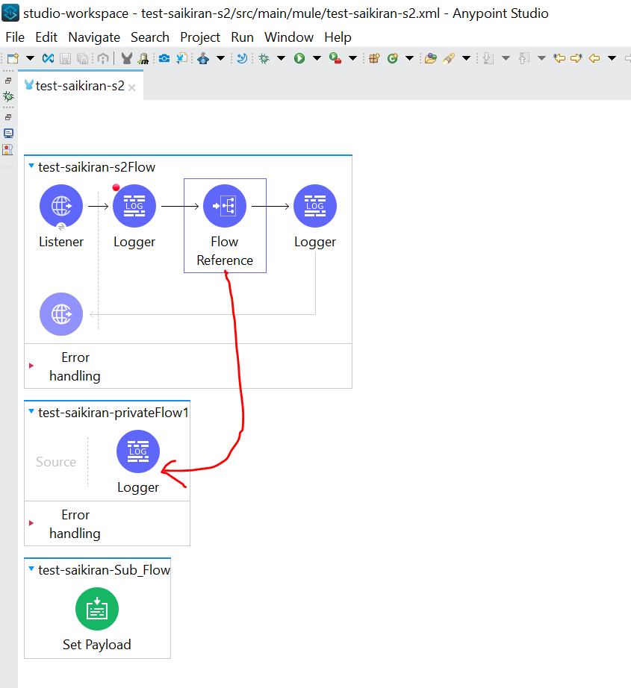
Flow reference
Flow Reference breaks the Mule application into discrete and reusable units
Flow Reference component in a flow to direct Mule to send a message to another flow for processing

Slide 46
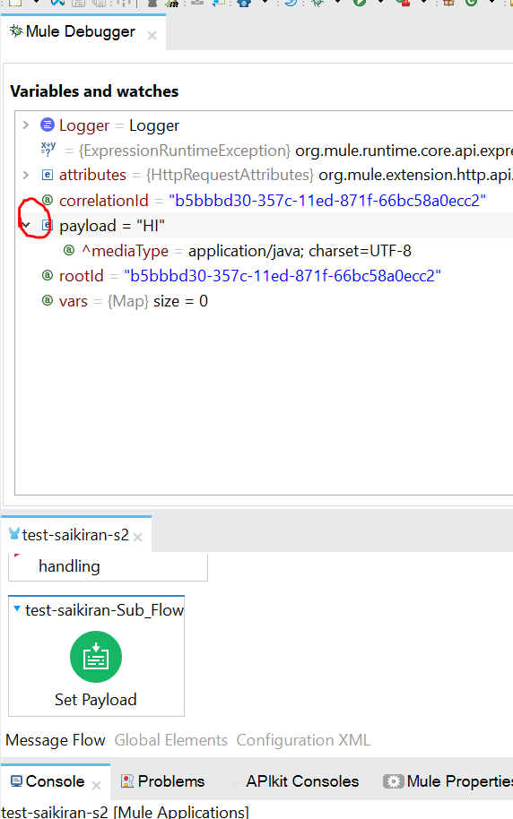
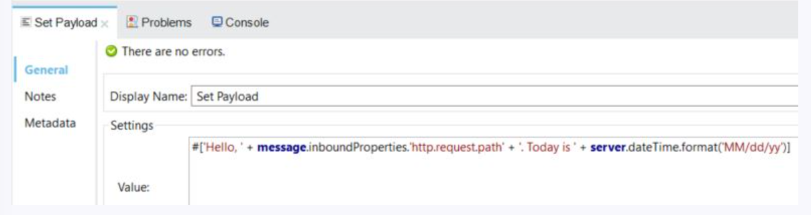
What is Set Payload
This transformer sets the payload to whatever you define. The payload can be a literal string or a Mule Expression.

Slide 47
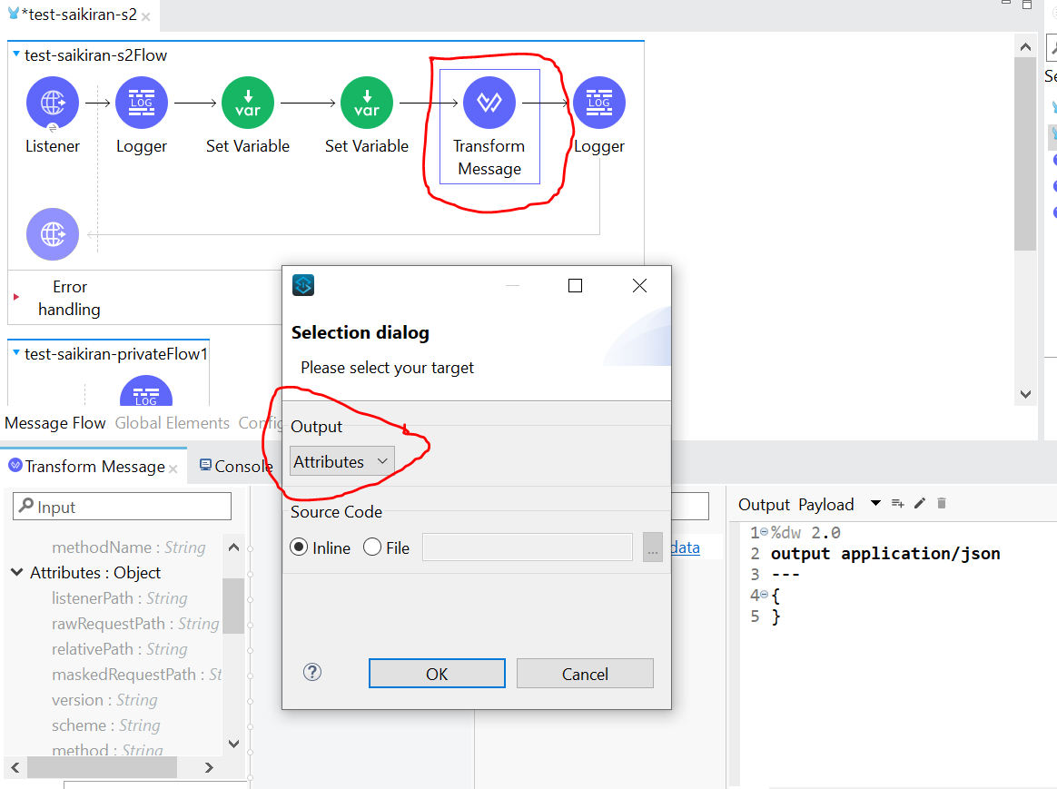
Transform Message
It also works same as Payload but it will also do the work of set variable
You can add n number of set variables to Transform message but only 1 payload can be added

Slide 48
Configuration properties
Properties or values that are used for best practice to extract some values from “property” files using corresponding key to avoid hard coding values
We can extract property values from property file by 2 ways
${} :- Used at anywhere (Config/Dataweave)
p(‘ ’) :- Used in Dataweave expression language scope

Slide 49
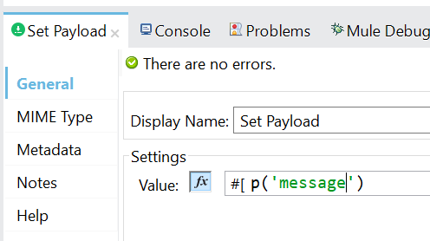






How to create config
Navigate to project -> src/main/resources -> RightClick -> File -> Create File -> config.properties (File Name)
After creating the file -> Go to Global elements -> Create -> configuration properties -> Name the file name which you created (config.properties)
P(): Can be used in Payload (eg: p(‘message’))

Slide 50


YAML
YAML is a human-readable data-serialization language. It is commonly used for configuration files and in applications where data is being stored or transmitted
Yaml structure (http.port: 8081) where config.properties are like (http.port = 8081)

Slide 51
DataWeave - Introduction
DataWeave is a MuleSoft expression language for accessing and transforming data
We can also access specific field inside payload
We can extract all kind of Data and Transform it through DataWeave
Transfer of data from one Format to another format is possible through DataWeave
Eg: XML to JSON, CSV to JSON etc…
More about DataWeave: https://www.tutorialspoint.com/mulesoft/mulesoft_dataweave_language.htm

Slide 52
DataWeave :- Preview Feature
Through preview we can see how the output generates without execution
It will help us to check whether if there are any syntax errors before execution
It will help us reduce time for debugging and development

Slide 53


Preview Through Sample Data

Slide 54


Preview through Payload data
Run the application
Set the payload data in Transform message
Request the data in postman to verify in response

Slide 55




Object & Array
Object is denoted with in { }, and it is having key-value pair
Array is denoted with [ ], It have only values
Link to Validate JSON:
http://jsonviewer.stack.hu/

Slide 56

Transforming One data type to Another
In Mule3, We have different connectors to convert data from one type to another
In Mule4, we use DataWeave to achieve this
Examples
JSON to XML
XML to CSV
JSON to CSV
XML to JSON

Slide 57




Transformation Data Pictures
Json
CSV
Xml
Java

Slide 58


Commonly Used operators

Slide 59
Map & Map Object syntax: map((value, index) ->{ }) mapObject((value,key,index)->{ })
map operators is used in Arrays
mapOject is used for Objects
map operators cannot be used inObjects
mapObject cannot be used for Arrays
$: Gives the value
$$: Gives the index of the field
$$$: Gives the Key of the field

Slide 60

Map working ($ working)

Slide 61

Map with (value,Index)
When you got map and give ctrl + space, It gives as below format
a map ((value, index) ->{} )
Upper keyword is used for Org, please check

Slide 62

MapObject : for Objects only

Slide 63

mapObject((key, value, index)->{})

Slide 64

Operator: Reduce
Reduce function is used to reduce Array into a single object
Implemented only on arrays

Slide 65

Reduce: Array of Objects

Slide 66

Operator: Pluck
Based on customer needs it plucks the value (it will be in the format of Array of Objects)

Slide 67


Pluck with joinBy

Slide 68


Operator: Flatten
Flatten combine all the data and gives the required data in sigle set of array

Slide 69


Flatten: Used to merge 2 or more array of objects/Objects into single array
Difference by using flatten kyword & Without flatten keyword

Slide 70

Filter Key in DataWeave
If we want to filter by key, value
-> eg : $.id>200
Note: We use filter for map( ) and filterObject for mapObject( )

Slide 71


groupBy in DataWeave
groupBy is used to group the array according to the key(id, name,…)
By ID
By name

Slide 72


orderBy in DataWeave
orderBy is used to keep the array in Order (Ascending/Descending)
Id
Name

Slide 73

distinctBy : To remove duplicate records (Unique date)

Slide 74

default : Not to store Null values
If the id/location/name is empty then a default placeholder will be set in that place

Slide 75

If-else in DataWeave
If-else is a conditional statement
Syntax:
Eg: Status: if($.marks >= 60) “Pass” else “Fail”

Slide 76


Task:- Learn about DataWeave Functions and come back
Link to Learn Functions/Methods:
https://www.w3schools.com/java/java_methods.asp

Slide 77


TypeCasting

Slide 78



Get Time with now(),now() as Date & Required format
Now() | “YYYY-MM-DDTHH:SS:MS.SSSZ”
now() as Date | “YYYY:MM:DD”
Now() as Date as String{format:’dd-MM-YY’} | “DD-MM-YY”

Slide 79

Date Country Wide

Slide 80
DataWeave Lookup
To call any “private flow” or Subflow we are using Flow reference
We can also call private flow component with DataWeave function called Lookup
We cannot call Subflow with with DataWeave function “Lookup”
Syntax: Mule::lookup(“private-flow-name”, “Payload can be passed here”)
Link: https://docs.mulesoft.com/dataweave/2.2/dw-mule-functions-lookup

Slide 81

Scatter-Gather
Scatter Gather sends the request message to multiple targets concurrently, It collects responses from various targets and aggregate them to a single message
Output payload is the combination all targets. And each target output has (Payload+attribute)
So its best practice to wrap every target within Try-Block with On-Error-Continue, So you can handle the errors and complete the process successfully
The total time taken to process all targets is the time took by single process (i.e Max 20secs)
Use Try, On error continue to avoid errors. Because if you get error even in one process, all processes will be stopped

Slide 82

Scatter Gather: Example

Slide 83

Choice Reutter
The Choice router dynamically routes messages through a flow according to a set of DataWeave expressions that evaluate message content
Choice-reutter is like if-else condition. It checks the positive and negative conditions and respond accordingly

Slide 84

Connectors

Slide 85
Important Thing to remember while working with connectors
File,SFTP, Database, Salesforce, any External web service etc… are some connectors
Gather the configuration details that are required while working with specific connector
See what is the request that particular system is accepting (Query param, Uri path, etc,.)
Check security that required to connect external system
Check what type of response returns back
Check what amount of time taking to get the response for particular request

Slide 86

Connector: Request
In http request, We are giving control to another system (External) or API and requesting them to give control over that system
Http Request is used to call other Web-services
Response is received from External system
It is placed in “Process” area of private flow (or) Subflow
We need to make sure on sending proper inputs to http Request components like URL, method, the input payload and attributes like query and uri param what ever web-service is expecting

Slide 87

Request : Mandatory Config details
Mandatory config details
Protocol (Http/https)
Method (Get/Post/Delete/Put)
URL or Path : If you provide whole URL, Then port base path are not required. If you give path, then host, port, path are necessary
You can pass Body, headers, attributes, queryParams in respective tabs
In the case of Error coming from Web-service, we are calling to be considered as success, then have make changes in response tab of Http Request and make use of Success-status-code-validator

Slide 88

Some External API’s we can use
Weather API:
https://openweathermap.org/api#current
Employees Data:
https://dummy.restapiexample.com/api/v1/employees
Configuring External API

Slide 89


Response of SetRequest is same as Rest API

Slide 90




Connector : Validation
Validation component verifies the content of the message whether it matches the specific criteria
-> There are a lot of validation connectors as listed below

Slide 91

VM Connector
Virtual Machine (VM Connector) manages intra-app and inter-app communication through either transient or persistent asynchronous queues
Transient Queues: Faster than persistent queues, But they are not reliable if system crashes
Persistent Queues : Slower but reliable
What is Transient Queue?
Transient Queues is used to make process Faster to store data in the memory, But they are not reliable if system crashes
Transient Queue is faster than persistent Queue
What is Persistent Queue?
Persistent Queues are slower while compared with the transient queues to store data in the memory, But they are reliable
Persistent Queue is Slower than Transient Queue
When we will use VM connector
If we want to pass the messages to another flow through queue mechanism instead of Flow-ref, We will go with VM Connector
Used Communicate between different apps with in Mule system
When we want to distribute work across the system

Slide 92
VM connector: Publish, Consume, Listener, Publish consume
Publish : Used to publish the message to queue and receive message from queue
Consume: Used to retrieve/Subscribe the data from Publish after the end of the main flow
Publish Consume: Used in place of Publish to retrieve/Subscribe the data from subscriber flow
Note: Using Post method

Slide 93




VM Config

Slide 94

Connector : Database
Mandatory config details required
Driver
Host
Port
User
Password
Database/service name/ instance
SQL Query text

Slide 95
Notes to Remember about Database
In Mule3, we used to have one database connector and we will be selecting the kind of operation that we want. Like Select, Update, Insert & Delete
In Mule4, We have separate connector for each operation
You can test the connection if you want to check if connection is successful
The “Output” type of select statement result is in “Array”

Slide 96






SQL Configuration

Slide 97
Notes to Remember about Database
FTP and SFTP are one and same except that SFTP used secured protocol
The way we connect the operations are all same for SFTP and FTP
Requires credentials for SFTP
Host, Port, username & Password are Mandatory configuration properties

Slide 98

Connector: File
Mandatory Configuration details
There are no particular configuration details to configure a file as it does not have any username & password
But the configuration need to be created for sure
In Mule4, We have separate connectors for each operation & You can check the connection whether it is successful
By Default, If we read a file, The file will not be deleted
You can extract the file name, size etc using attributes

Slide 99

Email connector
Email connector is used to send emails through smtp protocol
Dummy smtp address
https://pepipost.com/
Sign up the above url and got to sandbox to use dummy smtp server

Slide 100
Some Important operations in FTP/SFTP
Copy
Copy : It is like copy and paste
Create
Create Directory: Creating folder
Delete
Delete: Delete Folder/File
List
List: To bring all files in particular folder
Move
Move: It is like cut and paste(Move from one folder to another)
Read
Read, Rename, Write…

Slide 101

File:Write Operation
It will write/Store what ever data coming from Database to a File

Slide 102





Trigger a flow when new file is created/Modified
Config
Output File
Input File
Frequency setter
Auto Delete

Slide 103


Output
Run the flow
Place a demo file in Input
After Time Frequency it will move to the output folder & file will be deleted from input folder

Slide 104

Difference between File/FTP/SFTP
File | FTP | SFTP
Used to connect local system | Used to connect remote system | Used to connect remote system securely
Not requires any setup | Winscp is required software | Winscp, rebex sftp server softwares are required

Slide 105



Connector: Salesforce
Create Salesforce Account : https://developer.salesforce.com/

Slide 106

Security token is Important to connect -> Click on reset security token to receive it on mail

Slide 107

Salesforce Config
Mandatory Config details required:
Username
Password
Security token
Auth url
In Mule4, We have separate connectors for each operation & You can check the connection whether it is successful

Slide 108



Important points about salesforce
Salesforce accepts application/java (i.e, Array of objects)

Slide 109

Go to Object Manager

Slide 110

Look into the Fields closely and Apply the Fields present in Postman

Slide 111

Account created in Salesforce

Slide 112

Created Accounts in Salesforce Accounts

Slide 113
Queries in Salesforce
Select -> Used for select records from the database
Upsert -> Used for inserting and updating the records
Delete -> Used to delete the records

Slide 114

Connector : AWS-S3
Mandatory Config details
Access key
Secret key
Region
Where can we get Access key and Secret key
Inside Profile -> Security Credentials -> Access Key -> Displayed Over there (or) Create New
Aws cannot be found in modules, Install it from Exchange
We will call files as Bucket ins AWS

Slide 115

Error handling
What is an error?
An error occurs when an unexpected event happens while processing
What Is Error handling?
Exception handling is nothing but handling the errors while unexpected event happens while processing
Levels of error handling:
Flow level error handling
Connector level error handling
Custom error handling
Global error handling

Slide 116
At what levels we can do Error handling ?
At project level using default error handler
If we are not using any error handler, By default MuleSoft will handle the error and gives proper error message to the user
At project level using custom global error handler
Mule4 error handling is very easy when compared with Mule3
At flow level in exception handling using
On error continue
On error propagate
Raise error
With in flow or at process level using Try scope

Slide 117

Error handling : Important Notes
When even an error occurs in the flow, An error Object is Created
It contains many properties (error.description, error.errorType, etc,. )
ErrorType is combination of Name space and Identifier
Eg: HTTP:UNAUTHORIZED
Sub flow does not have any error handling
Either it is propagate or continue, Mule executes all the components with in the Block
How to identify the errors
Mule4 have the excellent feature on identifying the errors, By connectors we can able to identify the errors

Slide 118

Rules to understand Error handling
See if anything is present in error handling
Even if there are on-error propagate or continueblocks, see If that particular errorType is handled
If Not, Mule will use default error handling
If flow is called by any other flow, then it will raise the error to calling flow

Slide 119


Placing DB errors in Error propagate & HTTP errors in Error Continue
ON ERROR CONTINUE scope always returns a success response to the next level
ON ERROR PROPAGATE always propagates the error to the next level and returns an error response to the next level.

Slide 120


Creating Dummy HTTP request to see How the Error are handled by Default Error handler

Slide 121



On Error Continue
On placing HTTP:CONNECTIVITY error in the error handling block it will handle the error and triggers 200 response to with the payload message
On placing HTTP:OTHERS error in the error handling block it cannot handle the error and 500 response will be sent with the error message

Slide 122


On Error Propogate
On placing HTTP:CONNECTIVITY error in the error handling block it will handle the error and triggers 500 response
It is going to the calling flow if there is any error to handle with in On-Error Propogate

Slide 123


What happens if we Place On-error continue &Propagate as above
Placing a dummy URL in the request (HTTP:CONNECTIVITY)
In below case Propagate will execute and send 500 status to calling flow

Slide 124
On Error Propagate vs On Error Continue
On Error Propagate | On Error continue
ON ERROR PROPAGATE always propagates the error to the next level and returns an error response to the next level | ON ERROR CONTINUE scope always returns a success response to the next level
If the error is handled by using the On-Error Propagate, It will raise an error back to the calling flow | On error continue will not raise the error back to the calling flow and continue to next processor after “Flow-Ref” and continue further process as it is
Capture error and stop the execution of the flow and returns the error code with 500.. Status code | Captures the error and continues to the next level for execution, It always returns 200 status code

Slide 125


Raise Error:
We can have own type and Own description in Raise Error
It’s not like On-error (or) Continue to have default error cases
Eg: HTTP:NOT ALLOWED, DB:CONNECTIVITY
We cannot use the default error cases like HTTP, DB etc…, It should be defined by us

Slide 126

Scopes in Mulesoft
Try
Cache
Until successful
Aync
Message enricher
First successful
For each scope

Slide 127

Try scope
Try scope is used to handle the errors within a connector level

Slide 128

Cache scope
Cache scope will store previous requests and responses.
If there is any similar request, We will retrieve information from memory(Object store) instead of calling target system

Slide 129

First Successfull
The First Successful router iterates through a list of configured processing routes until one of the routes executes successfully. If any processing route fails execution (throws an error), the router executes the next configured route.
It is also similar to the scatter gather but in case of scatter gather parallel processing is done from a single source system to multiple subscriber systems but in case of first successful it executes the first successful record and ignores the remaining

Slide 130

Until successful
The Until Successful scope processes the components within it until they succeed or exhaust the maximum number of retries. Until Successful runs synchronously.
Max Retries: Specifies the maximum number of retries that are attempted
Milliseconds Between Retries: Specifies the minimum interval between two attempts to process, in milliseconds, Default value is 1 Min

Slide 131


FOR EACH
For each is used to process the records synchronously(1 by 1). It is a single threaded operation
Sample CSV files:
https://support.spatialkey.com/spatialkey-sample-csv-data/ https://support.staffbase.com/hc/en-us/articles/360007108391-CSV-File-Examples
3. POC: Take (On new or Update) file connector -> take input as CSV file record -> Transform it to Java -> Print records 1by1 in logger(For each scope)

Slide 132

Batch Processing
The messages are processed in batch
In Mule3 we have 3 phasess in Batch job
Input phase
Process phase
On complete phase
Input phase is removed in Mule4, We have only 2 phases
Load and Dispatch phase
Process phase
On complete phase

Slide 133



Real Time : Batch processing
Process only numbers
Take an array of inputs in the Payload (Eg: [1,2,"a",4,5,"b","c"])
Drag the batch job
We can add ‘n’ number batch steps in Process records
Processor: If there is any Logic like inserting and upserting the DB we will use processor
Aggregator: The number of processes inside data to be aggregated with

Slide 134

In 2nd Batch step Mentioning only failures(Strings)
Note: In Batch_JOB, Keep Max failed records as some number, Otherwise failed records will not be triggered to next Batch_step. Ref:1.0.1
Ref 1.0.1

Slide 135

ActiveMQ
Apache ActiveMQ is an open source message broker written in Java together with a full Java Message Service (JMS) client
If there are any records failing in Batch processing we can put them in queue and reprocess it again
Configure JMS config in MQ
We need to install tomcat Apache ActiveMQ https://activemq.apache.org/

Slide 136


To start ActiveMQ server
In Studio connector config Always username and Password should be admin
In apache activemq download, Go to bin path-> enter cmd -> press activemq start to start the server

Slide 137

Difference between Queue and Topic
Point to Point integration is known as Queue (1-1)
Publisher subscriber model is known as Topic (1-n)
A queue can have only one consumer, whereas a topic can have multiple subscribers.

Slide 138


ActiveMQ dashboard
We have publish to publish the message to the queue
Consume is used to consume the published queue in anther or same queue
publishConsume is used to publish and consume in the same queue

Slide 139


MUnits in Mule4
Munit is a developer level mock testing done by the developer after complete development process and the below are the operations to perform Munit testing

Slide 140

Munits Recorder & Manual testing
Munit recorder is used to generate the test validation automatically by postman call. It is an automated testing done by developer but pin Manual testing every setup need to be done by developer manually

Slide 141


Slide 142


Slide 143


Assert that
The Assert That event processor allows you to run assertions to validate the state of a Mule event's content.

Slide 144


Slide 145


Slide 146
More Important topics
HTTP Status codes
Postman
Git
Maven basics
Worker
Scaling in Mulesoft
Custom connector / Custom policies
Domain project
Cloudhub vs onpremises
Polling frequency
Load balancing
Deployment models in mulesoft
$, $$, $$$
Ajile and Waterfall methodology
Scrum master and Sprint
Lookup in DW
Implementation url
Message enricher & Target Variable
Object store
Splike control
Proxy API
API Kit router
Rate limiting
DB configurations

Slide 147
Important Things
Register training.mulesoft.com: https://training.mulesoft.com/home
Install Database (My SQL ) in Local machine
Link for MuleSoft Notes: https://www.tutorialspoint.com/mulesoft/index.htm
Link for Mulesoft Website: https://www.mulesoft.com/

Slide 148

Thank You
SAI KIRAN YALAKALA

